Slide 1
21BTB102T
Unit 1
Genetic Algorithms

Slide 2
Genetic algorithms (GA) in programming, simulate the process of natural selection which means those species who can adapt to changes in their environment are able to survive and reproduce and go to next generation. In simple words, they simulate “survival of the fittest” among individual of consecutive generation for solving a problem.

Slide 3
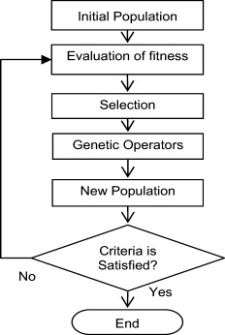
Genetic algorithms are based on an analogy with genetic structure and behaviour of chromosomes of the population.
Following is the foundation of GAs based on this analogy –
Individual in population compete for resources and mate
Those individuals who are successful (fittest) then mate to create more offspring than others
Genes from “fittest” parent propagate throughout the generation, that is sometimes parents create offspring which is better than either parent.
Thus each successive generation is more suited for their environment.

Slide 4
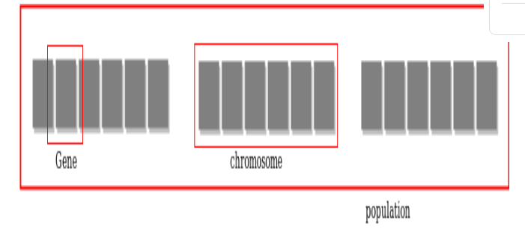
Components of a search space in Genetic algorithm
Gene represents a single solution to a problem
chromosome (individual) is composed of several genes or multiple similar solutions.
population of individuals are maintained within search space - all solutions to the problem
The whole algorithm can be summarized as –
Randomly initialize n populations
Determine fitness of population
Until convergence repeat:
a) Select parents from population
b) Crossover and generate new population
c) Perform mutation on new population
d) Calculate fitness for new population

Slide 5
Advantages-disadvantages of GA
Does not require any derivative information (which may not be available for many real-world problems).
Is faster and more efficient as compared to the traditional methods.
Provides a list of “good” solutions and not just a single solution.
GAs are not suited for all problems, especially problems which are simple and for which derivative information is available.
Fitness value is calculated repeatedly which might be computationally expensive
Being stochastic, there are no guarantees on the optimality or the quality of the solution.

